Slide 1

Operating Systems
BCSC 0004
Introduction to Operating Systems

Slide 2
Books
Operating System Concepts
Ninth Edition
Avi Silberschatz Peter Baer Galvin Greg Gagne
Operating Systems: Internals and Design Principles
William Stallings

Slide 3
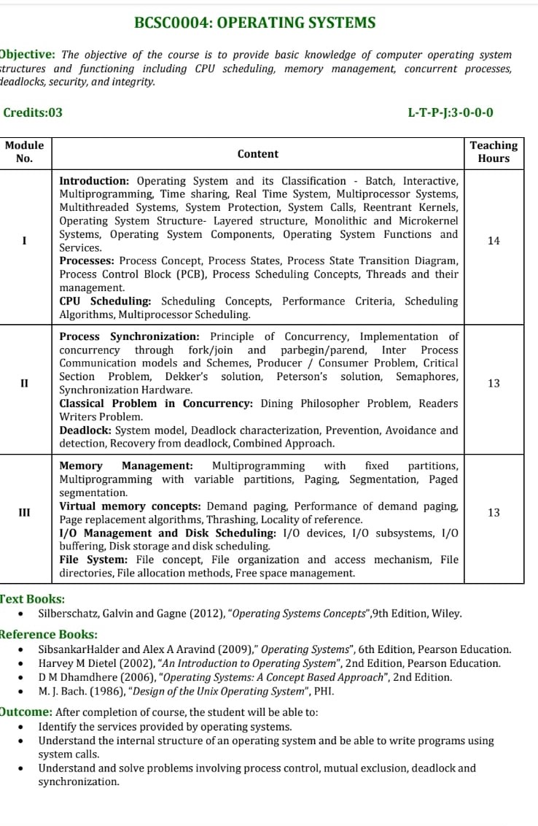

Slide 4
Architecture of Computer System
Hardware
Operating System (OS)
Programming Language (e.g., PASCAL)
Application Programs (e.g., WORD, EXCEL)

Slide 5
Computer System Structure
Computer system can be divided into four components:
  Hardware – provides basic computing resources
    CPU, memory, I/O devices
  Operating system- Controls and coordinates use of hardware among various applications and users
  Application programs – define the ways in which the system resources are used to solve the computing problems of the users
    Word processors, compilers, web browsers, database systems, video games
  Users
    People, machines, other computers

Slide 6
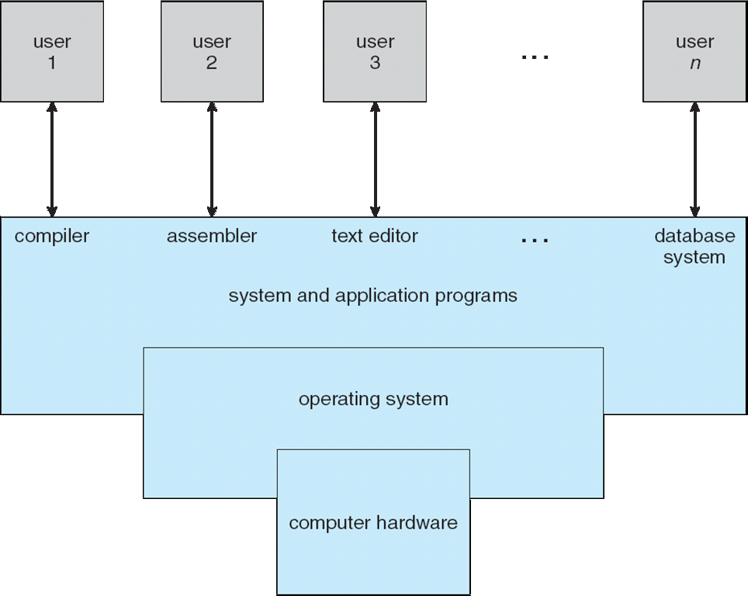
Four Components of a Computer System

Slide 7
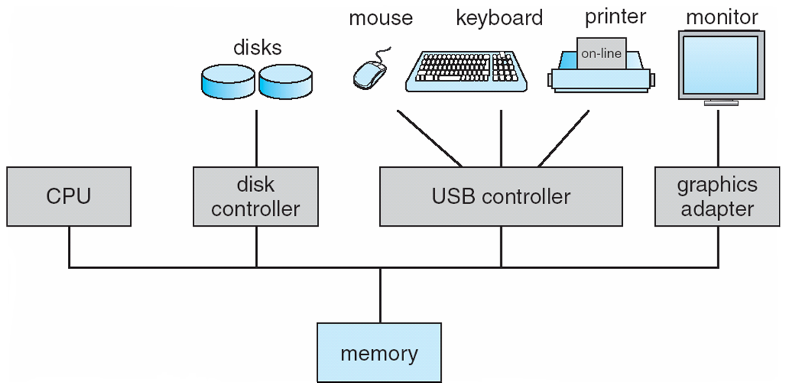
Computer System Organization
Computer-system operation
  One or more CPUs, device controllers connect through common bus providing access to shared memory
  Concurrent execution of CPUs and devices competing for memory cycles

Slide 8
History of operating system
First generation system (1945-55)
Vacuum tubes & plug board, No operating system
Second generation (1955-65)
Batch processing system, First OS was written for Intel
Used mostly for scientific & Engineering calculations.
Third generation (1965-75)
Batch processing system, but several jobs could run at a time, multiprogramming.
Fourth generation (1975-present)
PC’s came to begin, Desktop system as powerful as mainframe of 1970’s
Two OS are dominant MS-DOS, UNIX

Slide 9
Bootstrapping
Booting is the process of loading operating system into main memory.
For a computer to start running, it needs to have an initial program to load and execute the boot program, which in turn loads the operating system.
The primitive loader program that can load and execute the Boot program is called Bootstrap Program.
Boot strap program is generally stored in ROM.
On- Start up, the computer automatically reads the bootstrap program.

Slide 10
Definition of OS
A program that acts as an intermediary between a user of a computer and the computer hardware.
Conveniently and efficiently used hardware .
Manage resources in an unbiased fashion both hardware and software.
Provide a platform on which other application programs run.

Slide 11
Goal and Functions
  Execute user programs and make solving user problems easier
  Make the computer system convenient to use
  Use the computer hardware in an efficient manner
Function of OS
      Process Management
      Memory Management
      I/O device Management
      Network Management
      Security and Protection

Slide 12
Function of OS
Operating system are resource managers. The main resource in computer hardware in the form of
Processor Storage
I/O device Communication device
Some imp. OS function are
Implementing user interface
Sharing hardware among users
Allowing users to share data among themselves.
Preventing users from interfering with one another.
Scheduling resources among users.

Slide 13
Kernel in Operating System
Kernel is central component of an operating system that manages operations of computer and hardware.
It basically manages operations of memory and CPU time.
Kernel acts as a bridge between applications and data processing performed at hardware level using inter-process communication and system calls.
It is responsible for various tasks such as disk management, task management, and memory management.

Slide 14
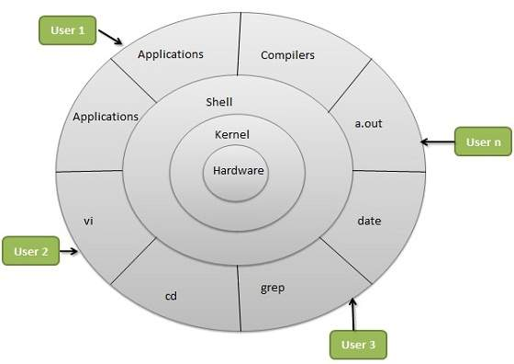

Slide 15
Types of Kernel
Monolithic kernel: It is one of types of kernel where all operating system services operate in kernel space. It has dependencies between systems components. It has huge lines of code which is complex. Ex. Unix, Linux
Micro Kernel: It has minimalist approach. It has virtual memory and thread scheduling. It is more stable with less services in kernel space. It puts rest in user space. Ex. Minix, AmigaOS
Hybrid Kernel: It is the combination of both monolithic kernel and mircro-kernel. It has speed and design of monolithic kernel and modularity and stability of microkernel. Ex Windows OS

Slide 16
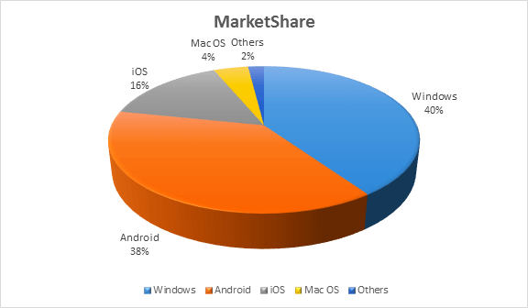
Operating System with Market Share

Slide 17
Classification of Operating System
Batch Operating System
Multiprogramming Operating System
Multitasking/Time Sharing OS
Multiprocessing OS
Real Time OS
Distributed OS
Network OS
Mobile OS

Slide 18
Batch Processing OS
In starting mainframe computers
Common I/P and O/P devices were card reader and tape drive.
User prepare a job which consisted of the program I/P data and control instruction.
I/P job given in the form of punch cards and result also appear in form of punch card after processing.
So, OS was very simple, always present in memory major task is to transfer control from one job to another job.
Computer
CPU
+
I/P
O/P
OS
User Program

Slide 19
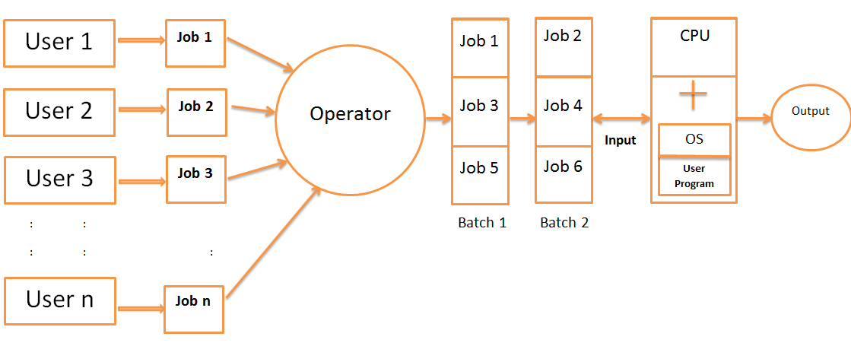
Batch Operating System

Slide 20
Batch Operating System
Jobs with similar needs are batched together and execute through the processor as a group.
Operator sort jobs as a deck of punch cards into batch with similar needs. Ex. FORTRAN batch, COBOL batch etc.
Advantage: In batch operating, job execute one after another, saving time from activities like loading and unloading the compiler.
Disadvantage: Priority can not be set for the jobs
              CPU may remain idle for a long time
              Lack of interaction between user and his job

Slide 21
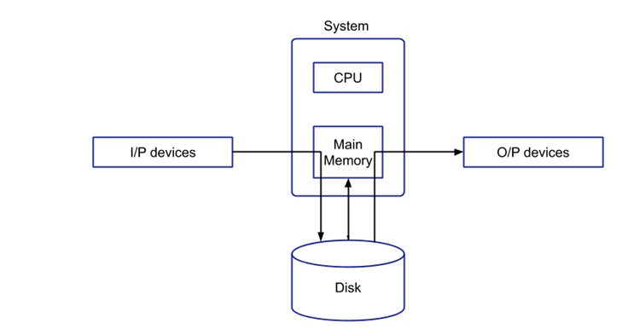
Spooling ( Simultaneous Peripheral Operation On-Line)
Handles I/O device data spooling as devices have different data access rates.
Maintains the spooling buffer which provides a waiting station where data can rest while the slower device catches up.
Input and output devices are relatively very slow compared to CPU(digital device), this OS saved much time from input/output.
Maintains parallel computation because of spooling process as a computer can perform I/O in parallel fashion.

Slide 22
Spooling ( Simultaneous Peripheral Operation On-Line)
Advantages of Spooling:-
The spooling operation uses a disk in which data is stored first and then the CPU interact with main memory for fetching the data.
Spooling is capable of overlapping input/output operation for one job with CPU operation of other jobs.
In this OS CPU utilization is more as CPU is busy most of the time.
Disadvantage of Spooling:-
The main disadvantage of Spooling is that it is very difficult to debug.
Due to lack of protection scheme, one batch job can affect the pending jobs

Slide 23
Multiprogramming Operating System
Maximize CPU utilization
Multiprogramming means more than one process in main memory which are ready to execute.
Process generally requires CPU time and I/O time so if running process perform I/O or some other event which do not require CPU then instead of sitting idle CPU make a context switch and execute some other process and this idea will continue.
CPU never idle unless that is not process ready to execute or at time of context switch.
Main Memory
OS
P1
P2
P3
.
.
Pn
Secondary Memory
CPU

Slide 24
Multiprogramming Operating System
Advantage:
    High CPU utilization
    Less waiting time, response time
    May be executed to multiple users
    Now a days useful then load is more
Disadvantage:
    Difficult scheduling
    Main memory management is required.
    Memory fragmentation
    Paging (Non contiguous memory allocation)

